Slide 1

Physics Simulation
CSE 191A: Seminar on Video Game Programming
Lecture 4: Physics Simulation
UCSD, Spring, 2003
Instructor: Steve Rotenberg

Slide 2
Physics Simulation
Particles
Rigid bodies
Deformable bodies
Fluid dynamics
Vehicle dynamics
Characters

Slide 3
Definitions
Kinematics: The study of motion without consideration of the underlying forces
Dynamics: Study of physical motion (or more abstractly, the study of change in physical systems)
Forward Dynamics: Computing motion resulting from applied forces
Inverse Dynamics: Computing forces required to generate desired motion
Mechanics, Statics, Kinetics

Slide 4
Particles

Slide 5
Kinematics of Particles
Position x
Velocity v = dx/dt
Acceleration a = dv/dt = d²x/dt²

Slide 6
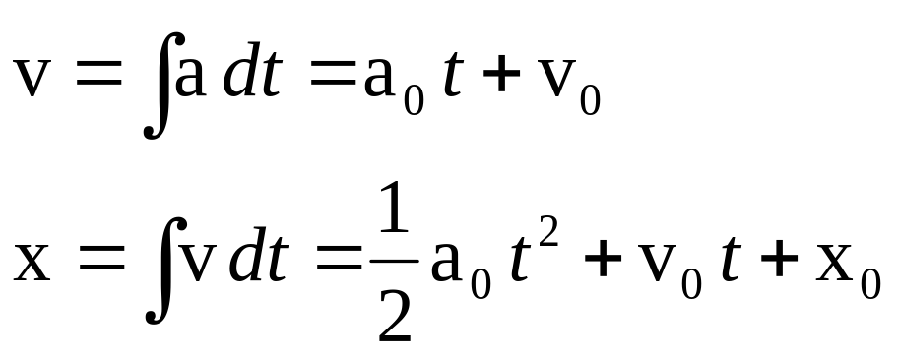
Motion Under Uniform Acceleration
Acceleration a=a₀
Velocity
Position

Slide 7
Mass & Momentum
Mass m
Momentum p = mv
Force f = dp/dt = m(dv/dt) = ma

Slide 8
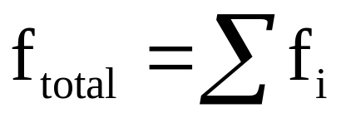
Forces
Forces cause change in momentum (accelerations)
Multiple forces can add up to a single total force:

Slide 9
Newton’s Laws
1. A body at rest tends to stay at rest, and a body in motion tends to stay in motion, unless acted upon by some force.
2. Forces lead to changes in momentum and therefore accelerations:
f=ma
3. Every action has an equal and opposite reaction.
f_{ij}=-f_{ji}

Slide 10
Gravity
Gravity near Earth’s surface is constant:
f=mg (g = -9.8 m/s²)
Gravity for distant objects:
f=Gm₁m₂/r² (G=6.673×10⁻¹¹ m³/kg·s²)

Slide 11
Particle Simulation
UpdateParticle(float time) {
  Force=ComputeTotalForce();
  Momentum=Momentum+Force*time;
  Velocity=Momentum/Mass;
  Position=Position+Velocity*time;
}

Slide 12
Integration
Explicit Euler method:
v=v₀+aΔt
x=x₀+vΔt
Many other methods:
  Implicit Euler
  Runge-Kutta
  Adams, Adams-Moulton, Adams-Bashforth
  Crank-Nicholson
  Multipoint
  Leapfrog
  DuFort-Frankel

Slide 13
Simulation Issues
Stability
Accuracy
Convergence
Performance

Slide 14
Forces

Slide 15
Spring-Damper
Spring-damper: f=-kx-cv
k=spring constant
x=distance from rest state
c=damping factor
v=velocity along spring axis

Slide 16
Aerodynamic Drag
Drag force: f=(1/2)ρa_{c}c_{d}v²
ρ=fluid density
a_{c}=cross sectional area
c_{d}=coefficient of drag (geometric constant based on shape of object, usually between 0 and 1, but can be higher)
v=velocity of the object relative to velocity of the fluid
Note: for simple cases, (1/2)ρa_{c}c_{d} is constant

Slide 17
Friction
Static friction: f ≤ f_{n}μ_{s}
Dynamic friction: f = f_{n}μ_{d}
f_{n}=normal force
μ_{s}=coefficient of static friction
μ_{d}=coefficient of dynamic friction

Slide 18
Force Fields
Generic force fields can be created that use arbitrary rules to define a force at some location: f=f(x)
Examples: vortex, attractors, turbulence, torus…

Slide 19
Collisions: Impulse
Impulse: J=Δp
An impulse is a finite change in momentum
Impulses are essentially large forces acting over a small time
Modified momentum update:
p=p₀+fΔt+J

Slide 20
Rigid Bodies

Slide 21
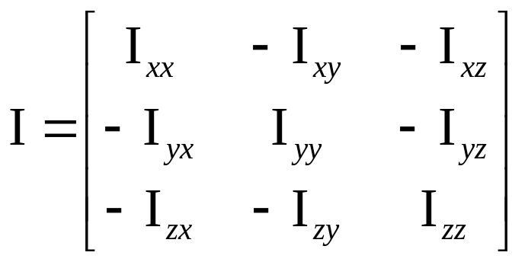
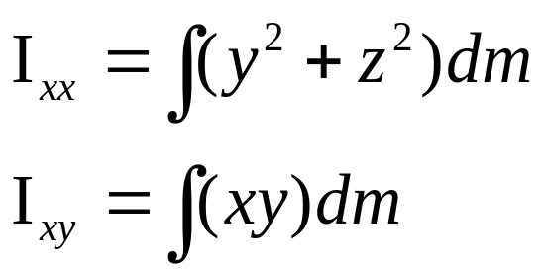
Rotational Inertia

Slide 22
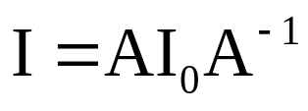
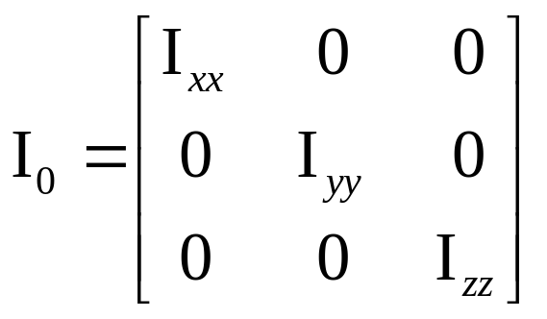
Principle Axes

Slide 23
Angular Momentum
L=Iω = AI₀A⁻¹ω
L=angular momentum
I=rotational inertia
ω=angular velocity
A=3x3 orientation matrix

Slide 24
Forces & Torques
τ=dL/dt
A torque is a change in angular momentum (similar to a force which is a change in linear momentum)

Slide 25
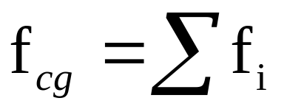
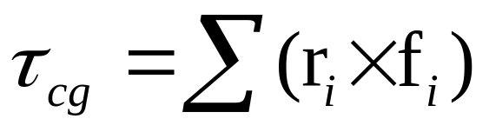
Offset Forces
Torque resulting from offset force: τ=r×f
Total force:
Total torque:

Slide 26
Rigid Body Simulation
UpdateRigidBody(float time) {
Force=ComputeTotalForce();
Torque=ComputeTotalTorque();
Momentum=Momentum+Force*time;
Velocity=Momentum/Mass;
Position=Position+Velocity*time;
AngMomentum=AngMomentum+Torque*time;
Matrix34 I=Matrix*RotInertia*Matrix.Inverse();
AngVelocity=I.Inverse()*AngMomentum;
Matrix.Rotate(AngVelocity*time);
}

Slide 27
Rigid Body Collisions

Slide 28
Advanced Topics
Contact: resting, sliding, rolling, stacking
Articulated bodies
Deformable bodies
Cloth
Fracture
Fluid dynamics
Vehicle dynamics

Slide 29
Using Physics in Games
Use physics for the things it is good at
Cheating
Clamping

Slide 30
Conclusion

Slide 31
Preview of Next Week
Character animation
Skeletons
Skin
Inverse kinematics
Animation
Locomotion

Slide 32
Physics References
Coutinho, “Dynamic Simulation of Multibody Systems”
Bourg, “Physics for Game Developers”

